Slide 1
Stoplight Healthy Living
Train the Trainer Webinar
Presented by
Kim Bruns & Dot Nary

Slide 2
Staff
Kim Bruns, Program Manager
kbruns@ku.edu Dot Nary, Health Promotion Coordinator
dotn@ku.edu
These materials were developed by Grant/Cooperative Agreement Number DD000006 from the CDC, National Center on Birth Defects and Developmental Disabilities, Disability and Health Branch. Its contents are solely the responsibility of the authors and do not necessarily represent the official views of CDC, NCBDDD, Disability and Health Branch.

Slide 3
Training Objectives
Provide an overview of Stoplight Healthy Living
Review activities and materials for the six sessions
Explain data collection tools and procedures
Answer questions
Confirm schedule for 6 sessions and 6 technical assistance teleconferences

Slide 4
Stoplight Purpose
To address health disparities* of adults with intellectual disability (IDD) by promoting good nutrition, increased physical activity and increased water consumption by:
Providing opportunities to learn about the importance of and how to implement:
Healthy food and drink choices
Physical activity
*health disparities are defined as preventable differences in health of a specific group within the overall population

Slide 5
Program Overview
Extends an existing evidence-based program: The Stoplight Diet
Uses a simple visual method of distinguishing healthy foods from less healthy and unhealthy foods with the color scheme of a stoplight:
Green (Go, eat all you want) (e.g., apples and carrots)
Yellow (Slow, use caution) (e.g., eggs and peanut butter)
Red (Whoa, eat rarely or never) (e.g., cookies and cake)
Has been used successfully in several weight loss trials with adults with IDD and with mobility impairments
Expanded from narrow focus on weight loss to emphasize health behaviors including increased physical activity and water consumption

Slide 6
Foundational Concepts
Promote choice and self-determination for participants
Focus on behavior change by reinforcing the importance of several healthy behaviors:
eating healthier foods
increasing physical activity
increasing water consumption
Involve disability service providers, such as case managers and direct support professionals (DSPs), who can provide ongoing support for healthy lifestyle choices after the formal program ends
Disseminate the program through disability service providers across the state via a train-the-trainer model

Slide 7
Stoplight 2020

Slide 8
Stoplight 2020 (continued)

Slide 9
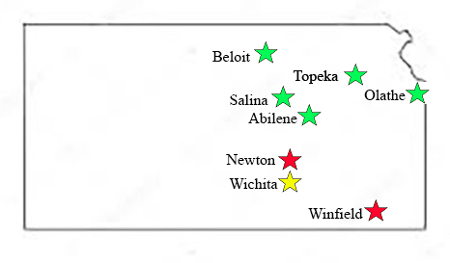
Stoplight Across Kansas

Slide 10
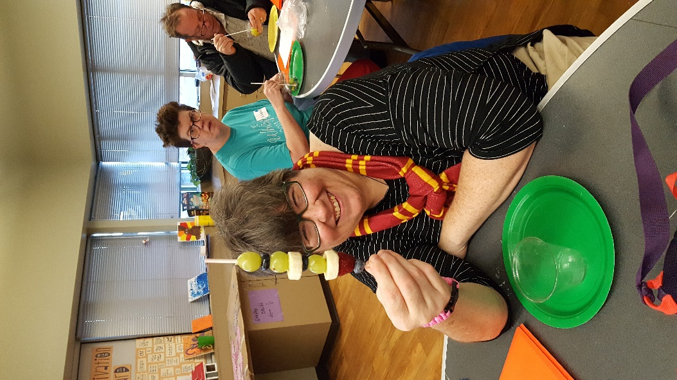
Participant Goals
Be healthy
Have fun
Value self-determination in making healthy choices
Support each other
Make small changes every day

Slide 11
Session Content
Designed to be delivered in six ~1.5 hour consecutive weekly sessions to groups of 6-8 participants
Common across all sessions
Information on healthy behaviors
Activities to reinforce new knowledge or put it into practice
A healthy snack to demonstrate that healthy foods can be delicious

Slide 12
Introduction to Manual
Facilitator/participant ratio
Including other attendees
Setting/equipment
Estimates of session times
Sequence of snack activities
Evaluations and facilitator checklists
Physical activity for participants who use wheelchairs
Support needs of participants
Prompts between sessions
Taking photographs
Frequently asked questions

Slide 13
Setting/Equipment
To deliver Stoplight sessions, the following are required:
a large room with tables and chairs that allows participants to both move around and do seated activities
equipment including a large screen and speakers to project videos and music for a group (not just a laptop)
internet access for programs and for technical assistance meetings
kitchen facilities to prepare and clean up after snacks

Slide 14
Delivering the Sessions
Review materials before the sessions
Aim to use session plan scripts loosely—not word for word
Encourage participation by asking participants to distribute materials, soliciting show of hands, etc.
Facilitate peer support for participants
Show that small changes can make a big difference
Make it fun!
Take photos and send them to us—they will help us to promote the program!

Slide 15
Session Themes
1. Introduction to the Program
2. Get Moving
3. Healthy Drinks and Snacks
4. Healthy Meal Preparation
5. Shopping for Healthy Foods
6. Healthy Eating Out & Celebration!

Slide 16
Session One: Introduction
**Pre-program evaluation**
Introduce the Stoplight concept of food groups: GREEN, YELLOW and RED
Discuss groups of foods that participants report eating often
Use My Plate placemat and pictorial food cards to a assemble healthy meal
Plan to put GREEN, YELLOW and RED stickers on appropriate foods at home (e.g., green on fresh apples, yellow on low fat yogurt, and red on cookies)
Notes:
Trainer:
Review food groups in detail. Review My Plate concepts. Discuss
Tips for delivering sessions
In introducing food lists,
Note that not ALL foods are on the list—it is a guide and would be very long if all foods were included. Emphasize choosing more foods from the GREEN list. If we can get people to eat more foods from the GREEN list and fewer from the other lists, that is a win!
Try to emphasize what foods they already eat from the GREEN list—encourage them to try new foods from that list.
Provide guidance for My Plate activity—some participants may put 10 foods on their plate, others will not choose a balanced meal. Encourage them to choose foods from the correct groups. Discussion of sticker activity, before and after, is as important as the actual activity of placing stickers.

Slide 17
Session Two: Get Moving
Check-in on what foods were labeled at home
Discuss what exercise does to your body to make it healthy
Think of different ways to increase physical activity
Exercise to a video routine
**Post session evaluation**

Slide 18
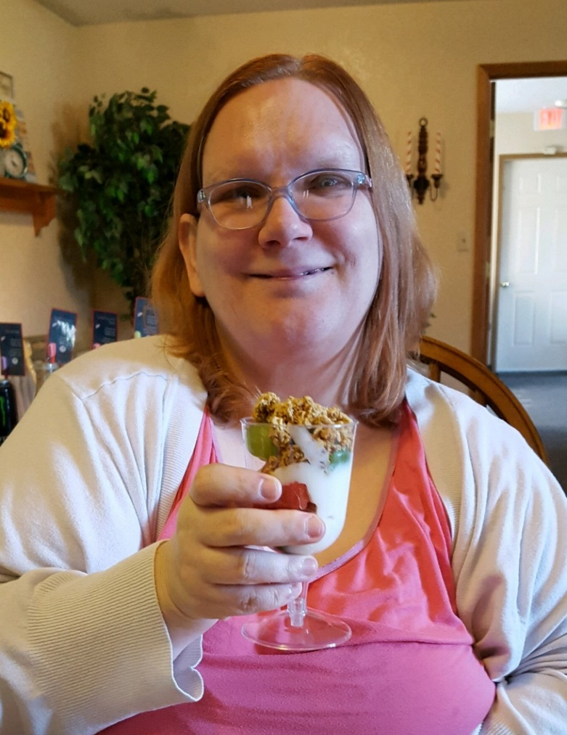
Session Three: Healthy Drinks & Snacks
Guess the amount of sugar in drinks using Oral Health Kansas Sugary Drink display
Exercise session
**Post-session evaluation**

Slide 19
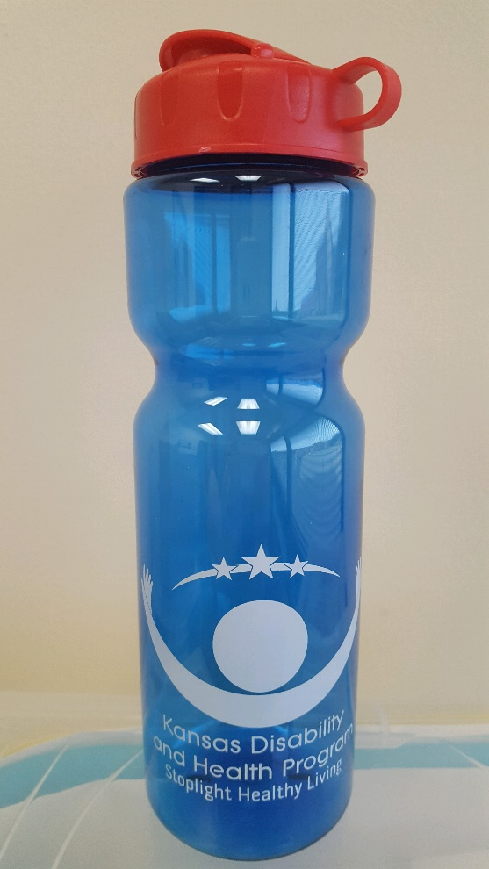
Session Four: Healthy Meal Preparation
Exercise session
Discuss how to make common foods healthier and use more foods from the GREEN group
Discuss how to consume more water
**Post-session evaluation**

Slide 20
Session Five: Shopping for Healthy Foods
Exercise session
Activity to put pictorial food cards in GREEN, YELLOW or RED shopping bags
Video and discussion-Awesome Mary Shops the Rainbow
Distribute and discuss color-coded grocery shopping lists (GREEN, YELLOW, and RED foods)
**Post-session evaluation**

Slide 21
Session Six: Healthy Eating Out & Celebration
Discuss and role-play ordering healthier foods at fast-food restaurants
**Post-program evaluation**
Distribute Certificates of Completion and recognize individual achievements
Hold dance party or play Bingo with music and healthy snacks

Slide 22
Program Completion & Make Up Sessions
For funding purposes, Stoplight Healthy Living participants are considered to have completed the program if they attend the following group sessions and complete evaluations for each:
Session 1
Session 6
And two additional sessions
If participants miss sessions, and facilitators are willing to do individual “make-up” sessions, that is very helpful to provide the information that can help participants improve their health.

Slide 23
Facilitator Checklists
Important for us to evaluate the fidelity and efficacy of Stoplight
Should be completed as soon as possible after sessions end
Help us to know how the content was delivered
Details help—tell us which activities participants enjoyed; which were more difficult to deliver; suggestions for change; any evidence, from observation or conversation, that participants adopted healthier behaviors
Send after each session by scanning and emailing, or by USPS
We will be waiting to receive them to use the information to improve the program!

Slide 24
Memorandum of Partnership
Outlines the responsibilities and duties of both the Disability and Health Program and the partnering organization in delivering Stoplight Healthy Living
Requires signatures of both parties, including an administrator of the partnering organization
Clarifies roles and lays the groundwork for a cooperative working relationship

Slide 25
Letter to Supporters
⧫ Sent at the start of the program
⧫ Supplemented by weekly messages advising what participants are learning and how supporters can help them to implement the information to live healthier lives

Slide 26
Technical Assistance
Consists of a ~30-minute Zoom meeting after sessions 2, 3, 4, 5, 6
Both facilitators should attend
Important because we don’t expect you to remember everything from today’s training!
Opportunity to share information and troubleshoot
Let’s schedule this now!

Slide 27
Stoplight Supply Kits
Supplies are provided, with forms filed by session
Number of items sent will be based on the number of participants you report on your planning form
Funds will be provided to purchase food for snacks
How will your organization access funds to purchase snacks?

Slide 28
Evaluations (worksheets)
Evaluations are important for us to show that the program is effective
We are also looking for ways to improve the program
Conducted
Start of Session 1 (pre)
After Session 2,3,4,5
After the role-play segment of Session 6 (post)
Should be completed on the two tablets provided with responses transmitted automatically upon completion
Available on hard copy (only as a backup)

Slide 29
Worksheet

Slide 30
Q & A

Slide 31
The End!
Q & A

